Slide 1
Appendicitis in Children
Ijeoma Njoku
12/5/2024

Slide 2
Objective
My objective is to use patient data to predict whether a child has or not. I will do this by using their lab work and excluding their general demographics such as gender or height.
Task Type:
This would be a classification problem because the goal is to determine if a child has appendicitis or not.

Slide 3
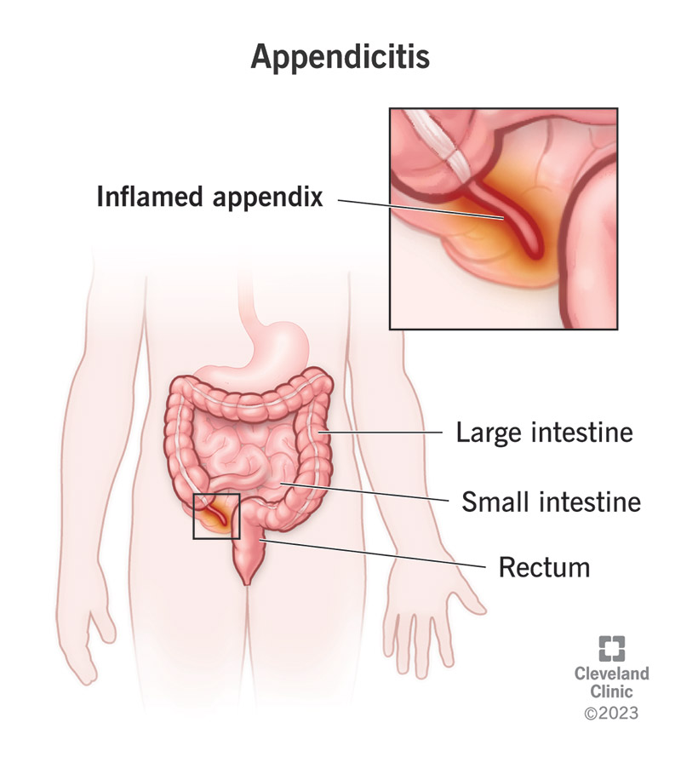

Slide 4
Data Overview
Instances: 782
Number of Features: 19
My dataset originally included 56 features, but I removed all the demographics and only focused on the lab data from patients.
Conventional Model: Train (80%) Test (20%)
DNN Models : Train(70%) Test (15%) Val(15%)

Slide 5
Target Variables
The target variables that could have been used in my analysis
Diagnosis
Severity
Management
The class variable I chose defines whether the child has appendicitis or not. (Diagnosis)

Slide 6
Conventional Model Performance Summary Table *test data only*
 | Logistics | Decision Tree | Random Forest | SVM | ADA Boost | Gradient Boost | XGBoost | Light GBM | CatBoost
Accuracy | 0.68 | 0.62 | 0.73 | 0.70 | 0.71 | 0.71 | .065 | .70 | 0.67
F1 Score | 0: 0.62 1: 0.71 | 0: 0.56 1: 0.67 | 0: 0.62 1:0.79 | 0: 0.63 1: 0.75 | 0: 0.61 1: 0.76 | 0: 0.59 1: 0.78 | 0: 1.00 1: 1.00 | 0: 0.62 1: 0.75 | 0: 0.59 1: 0.73
Sensitivity (Recall) | 0: 0.52 1: 0.79 | 0: 0.61 1: 0.63 | .81 | 0: 0.62 1: 0.75 | 0: 0.56 1: 0.81 | 0: 0.51 1: 0.85 | 0: 1.00 1: 1.00 | 0: 0.60 1: 0.77 | 0: 0.58 1: 0.74
Specificity | 0.5 | 0.61 | 0.85 | 0.75 | 0.54 | 0.48 | 0.58 | 0.59 | 0.58

Slide 7
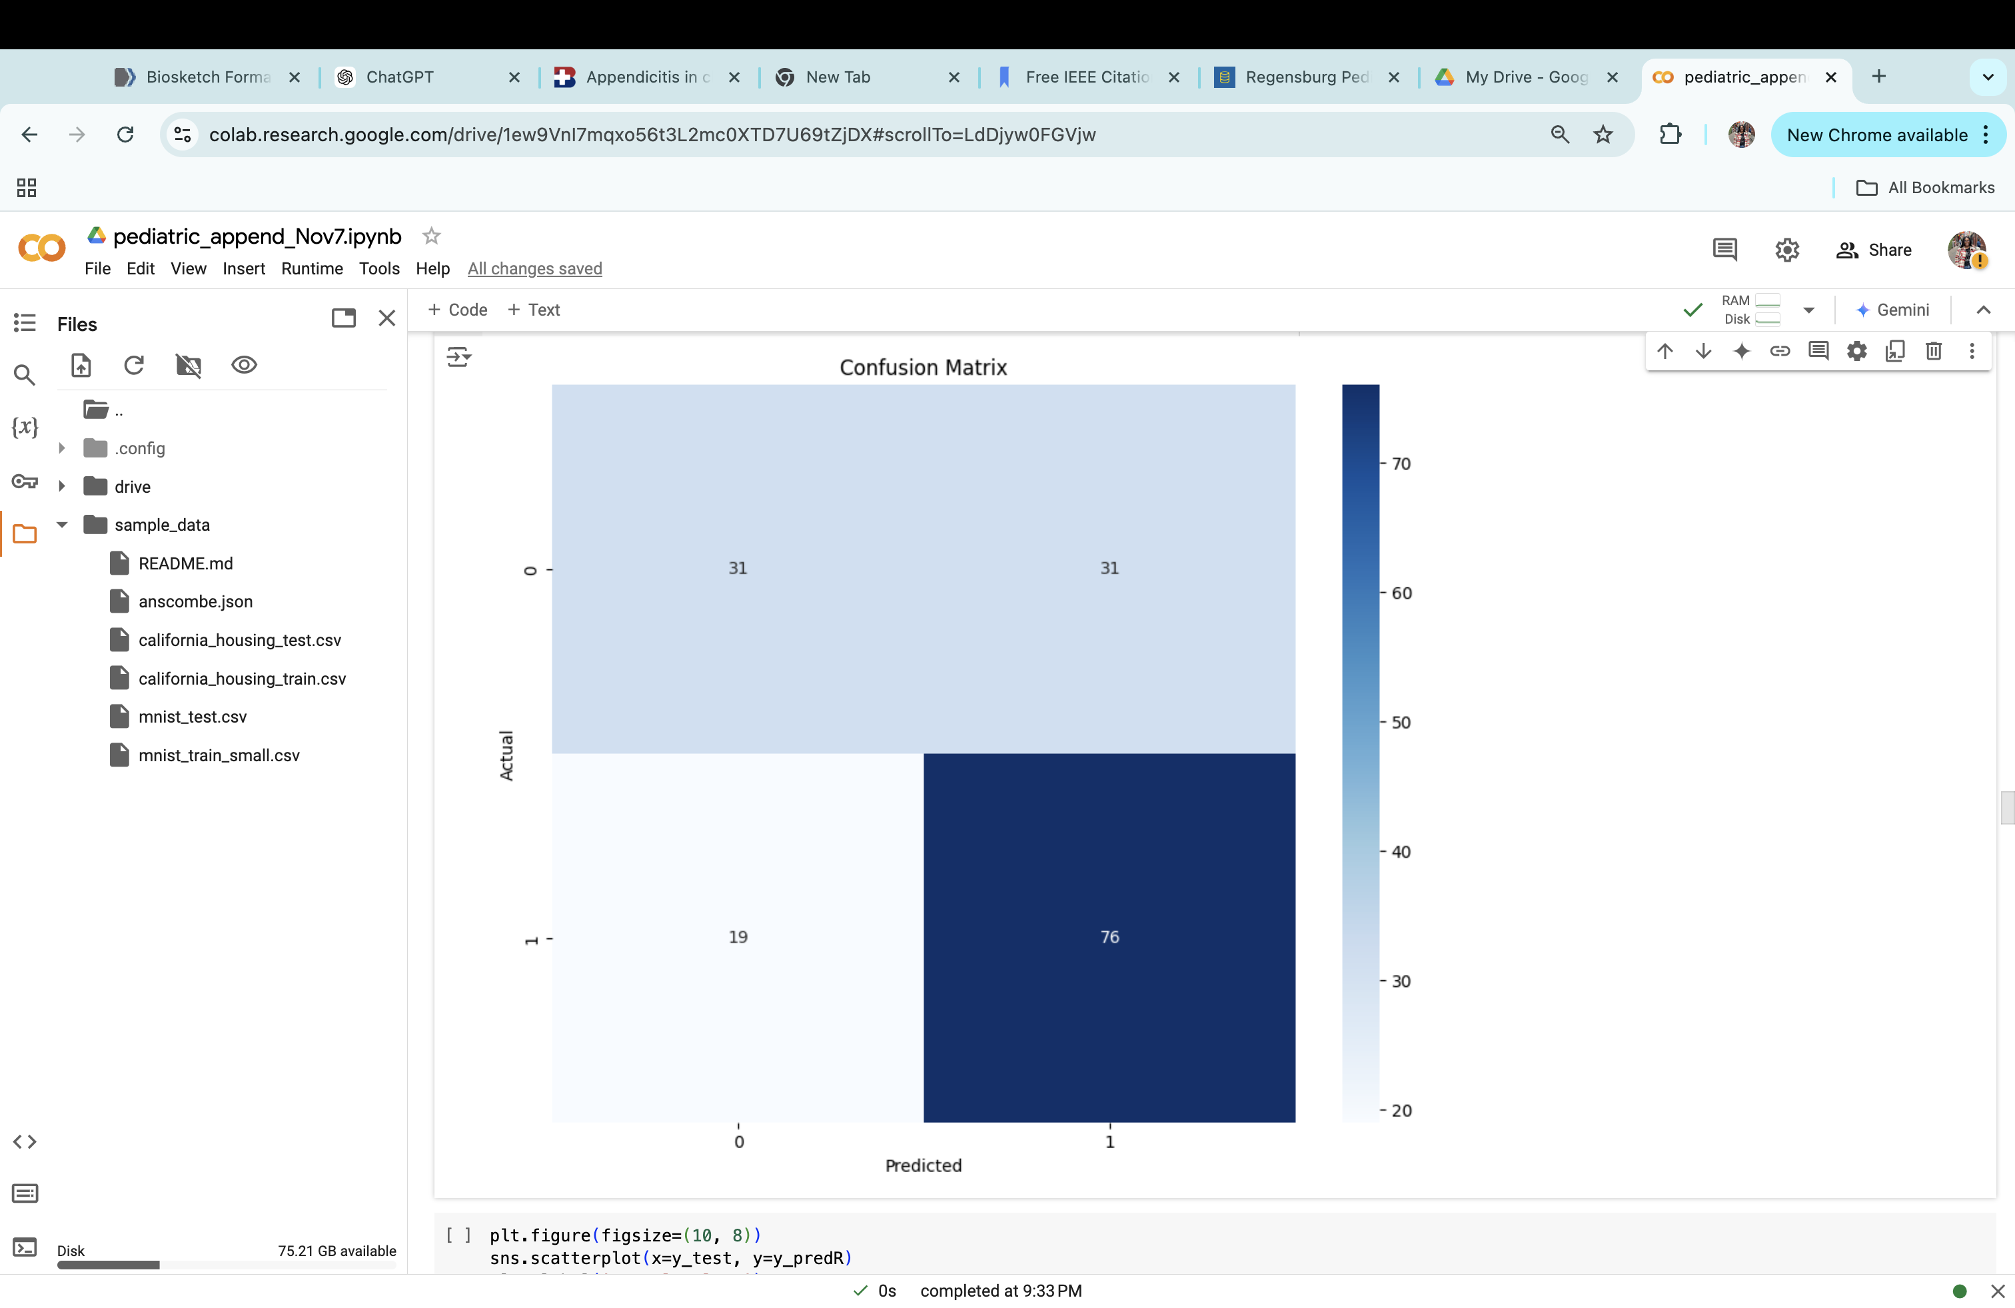
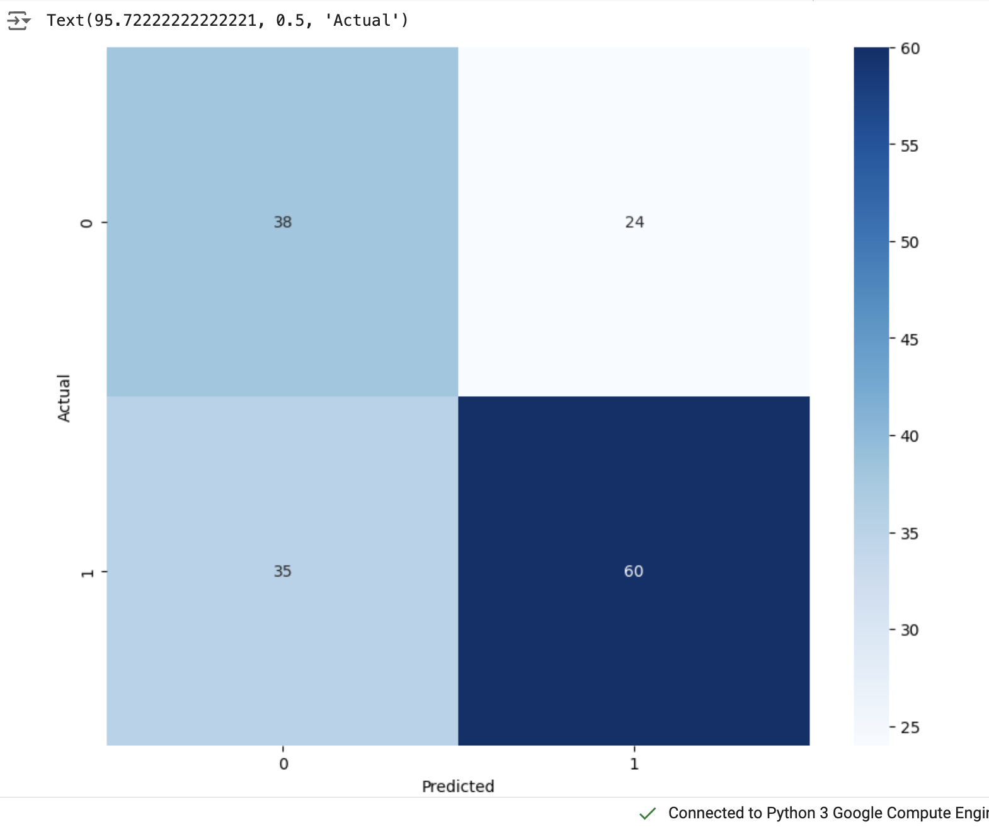
Confusion Matrix
Logistic Regression
Decision Tree

Slide 8
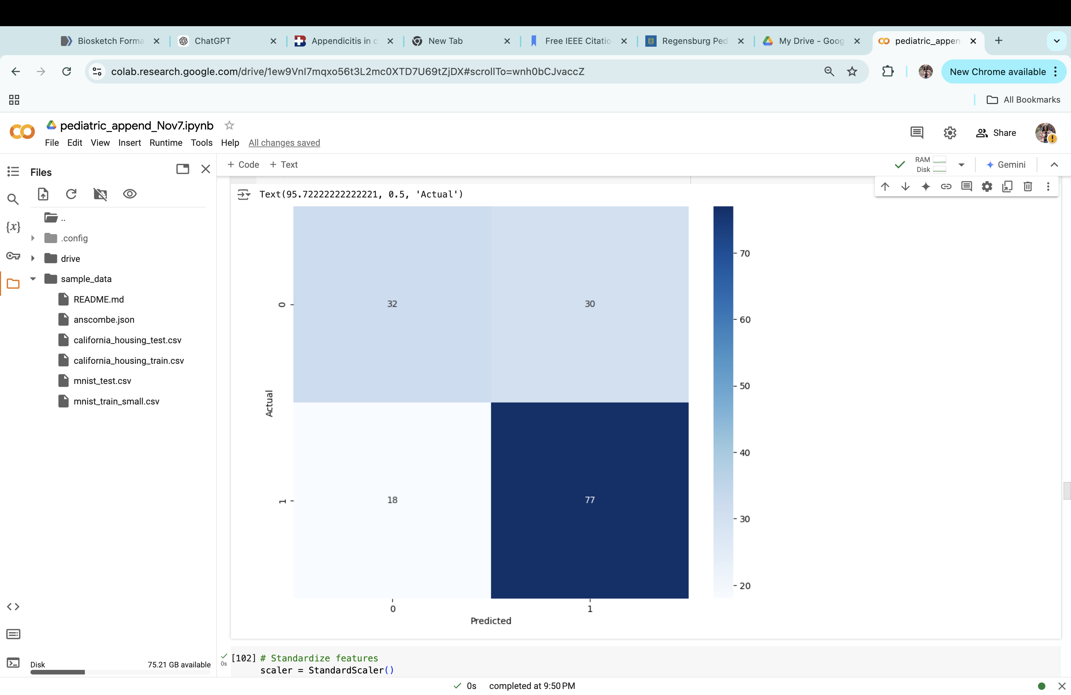
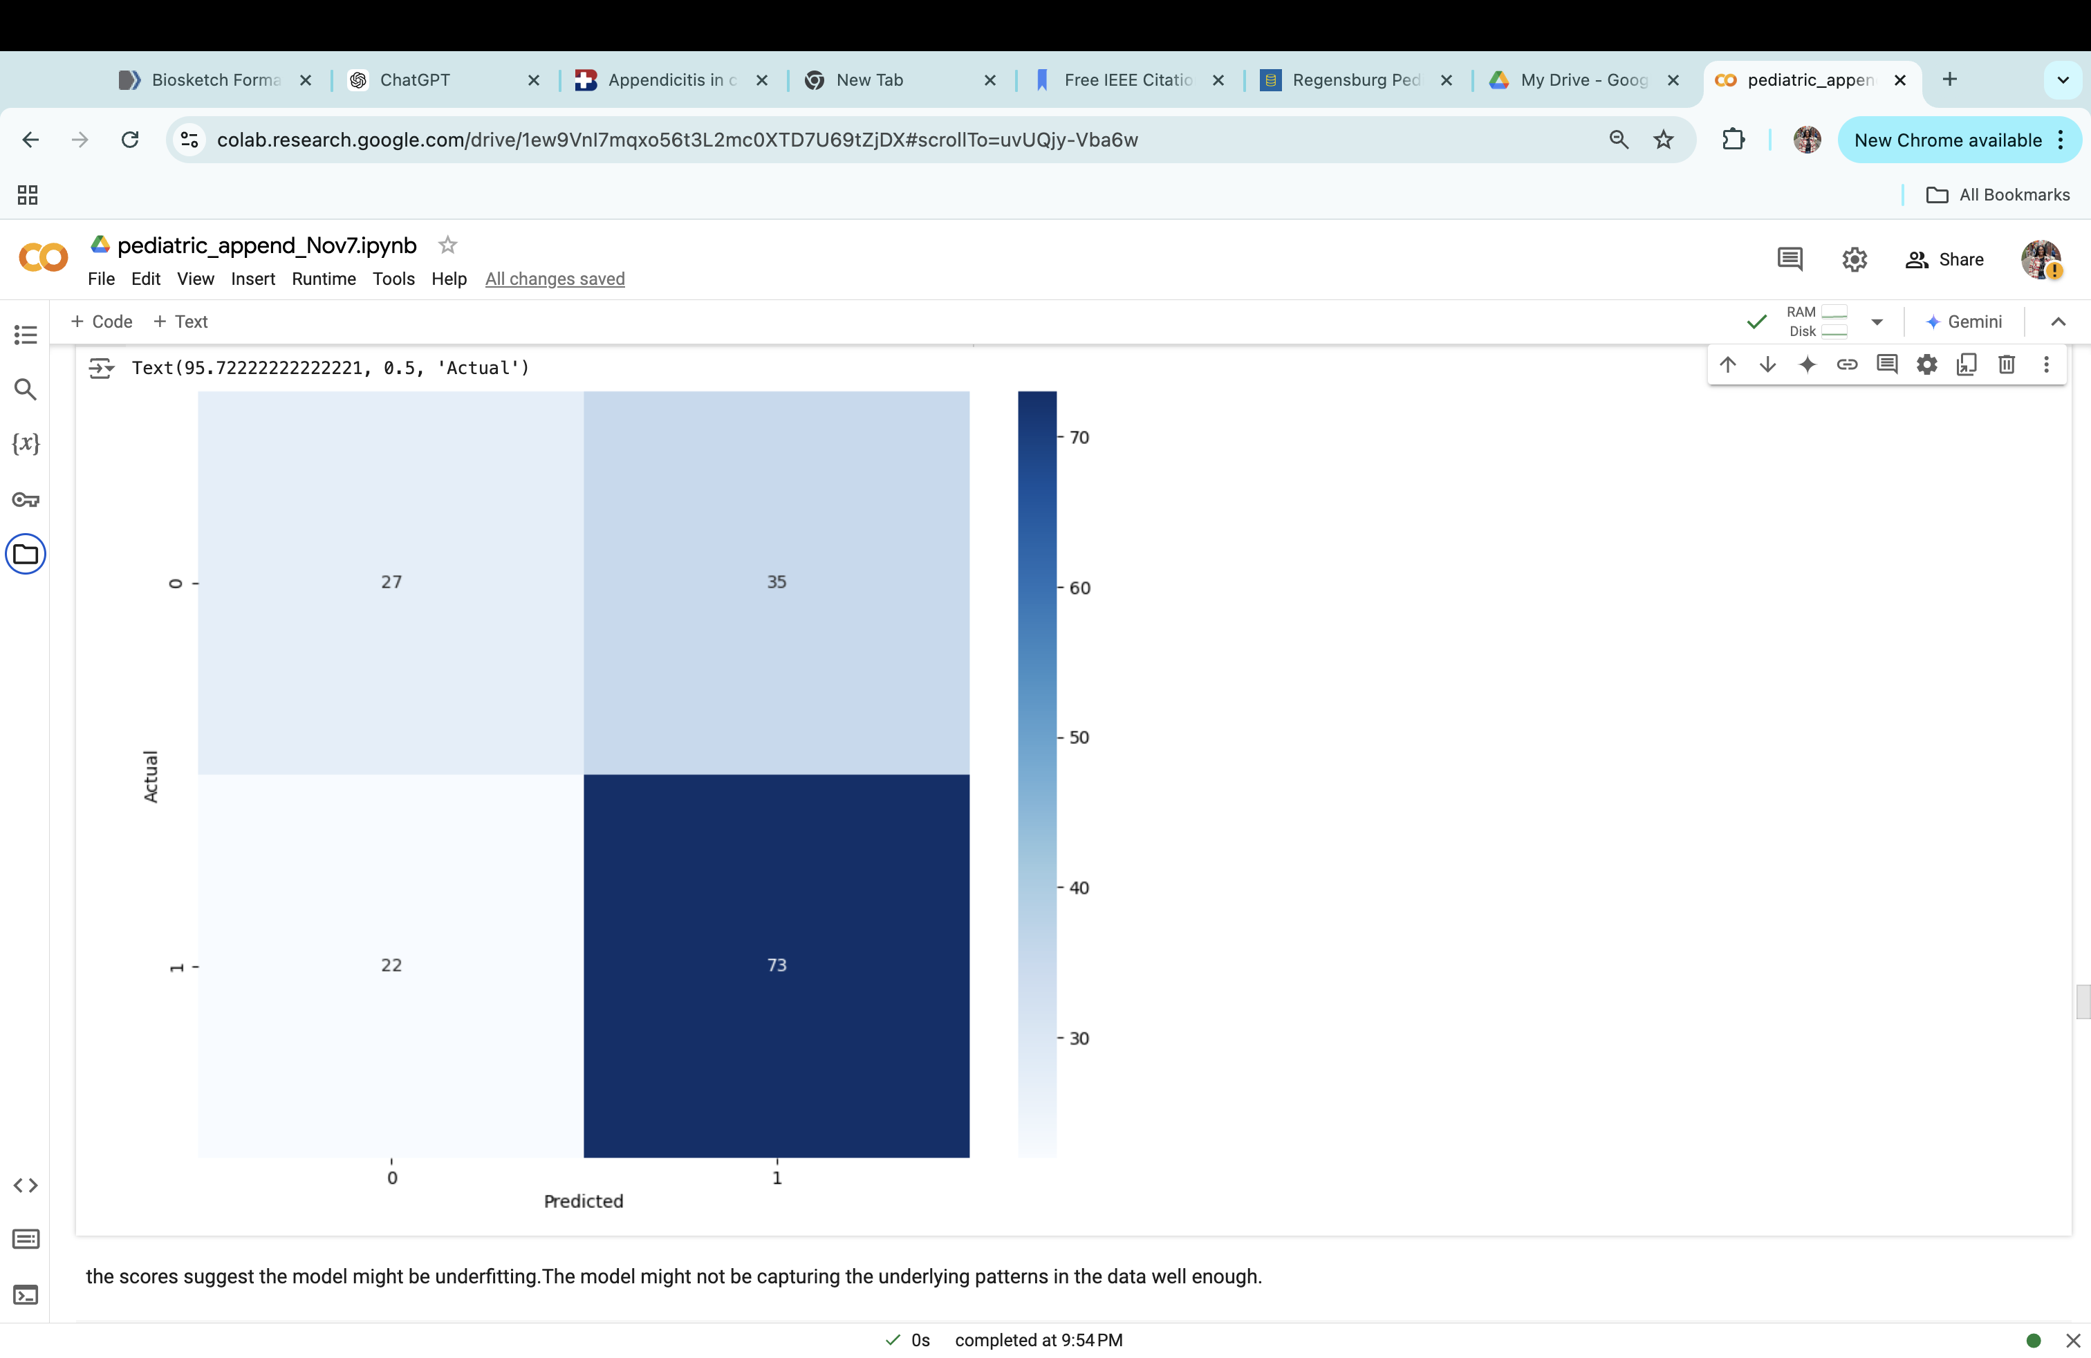
Confusion Matrix
Random Forest
Support Vector Machine (SVM)

Slide 9
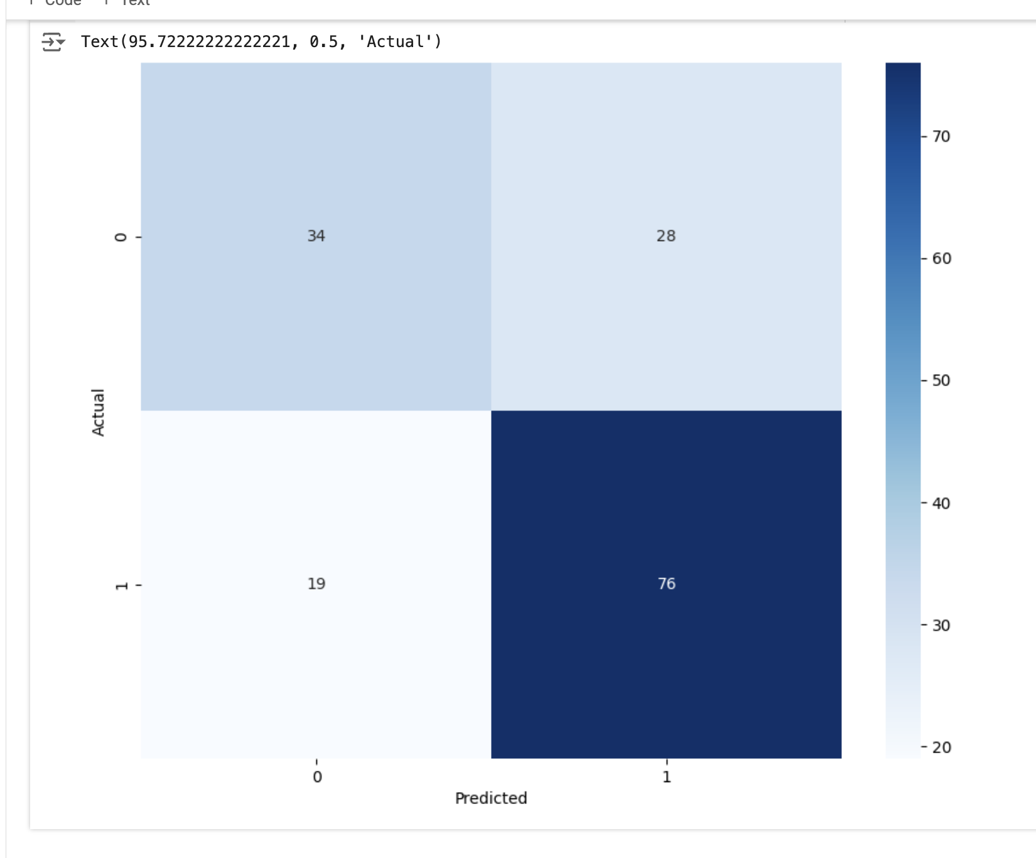
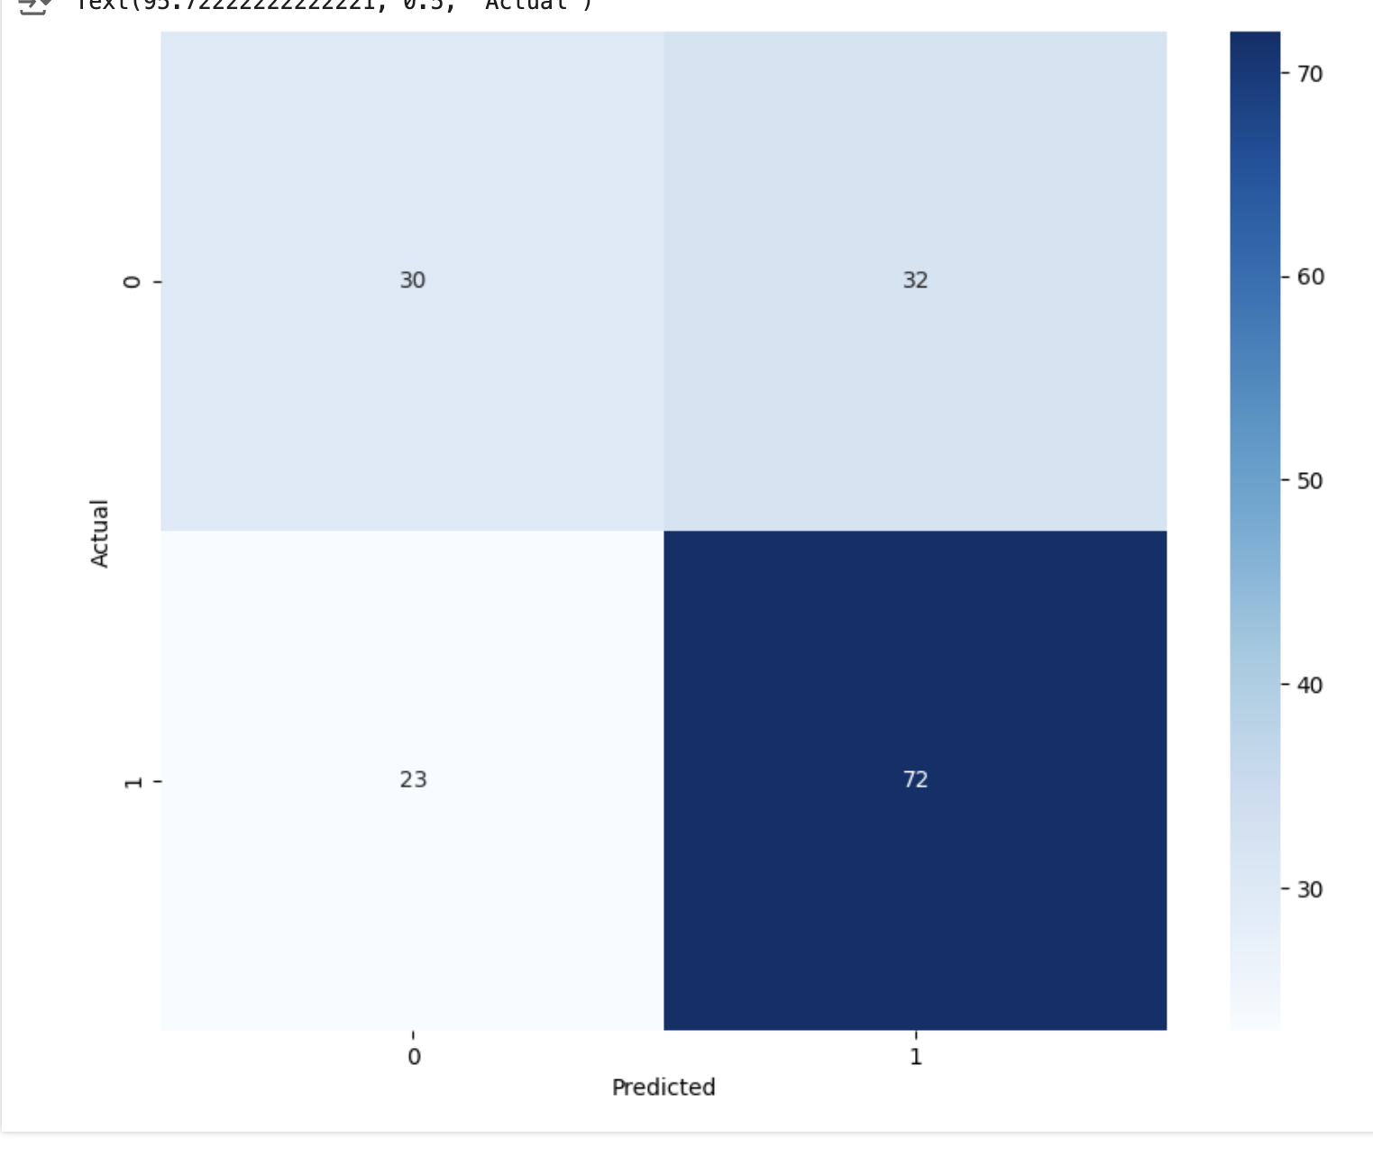
ADA Boost
Gradient Boosting

Slide 10
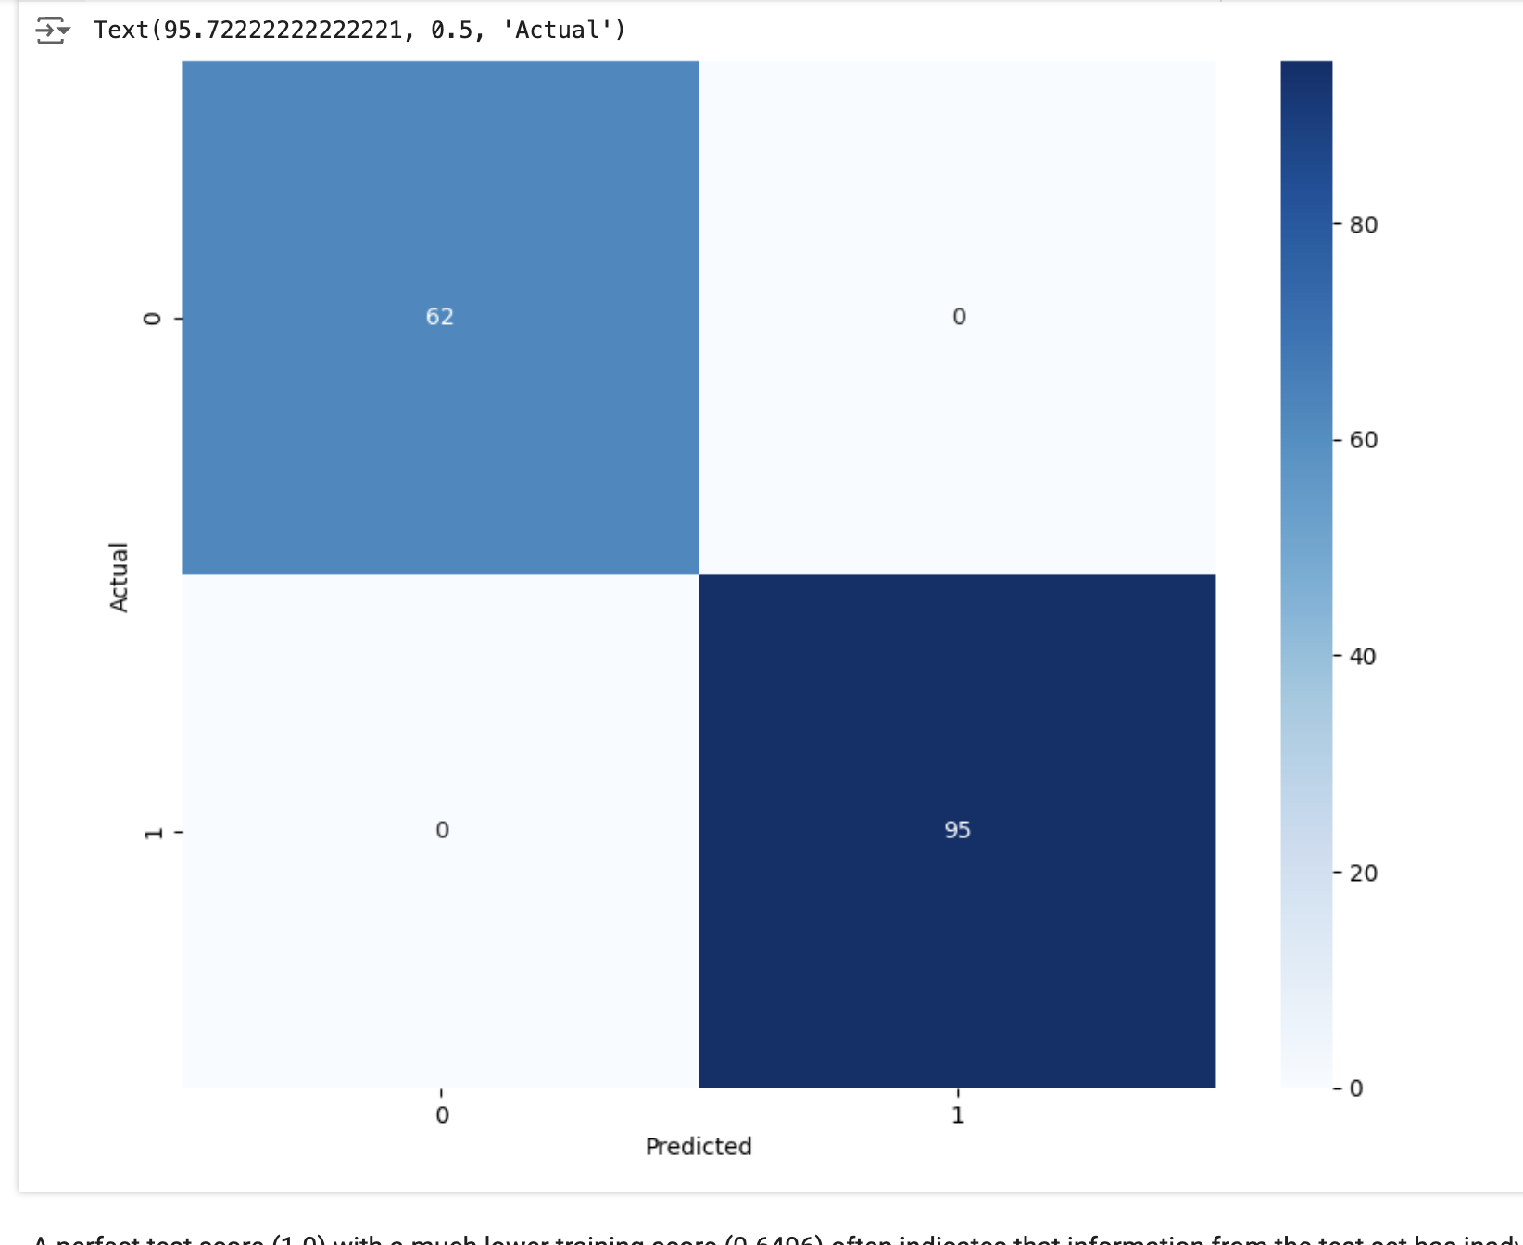

XG Boost
Light GBM

Slide 11
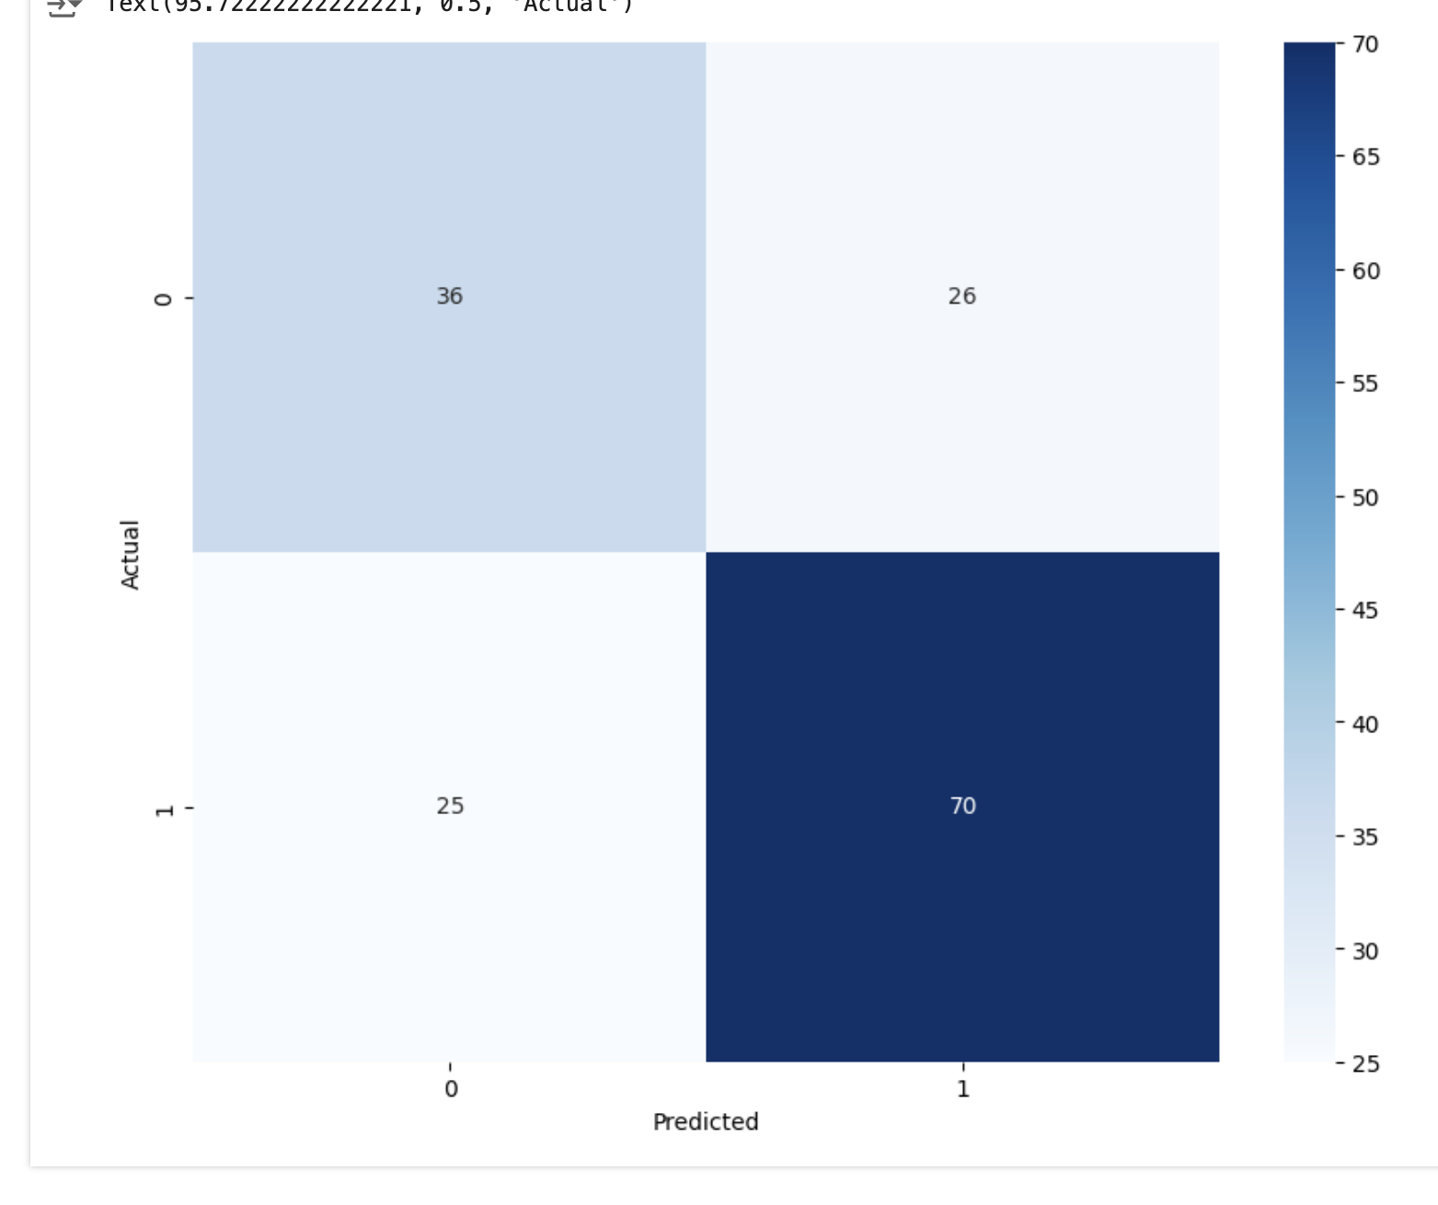
Cat Boost

Slide 12
Deep Neural Network (DNN) Evaluation Results
Test | Accuracy | Sensitivity | Specificity | F1 Score | Precision
Base Model | 0.987 | 0.71 | 0.71 | 0.69 | 0.68
Tuned Model 1 | 0.59 | 1.00 | 1.00 | 0.74 | 0.59
Tuned Model 2 | 0.59 | 1.00 | 1.00 | 0.74 | 0.59
Validation | Accuracy | Sensitivity | Specificity | F1 Score | Precision
Base Model | 0.69 | 0.80 | 0.80 | 0.69 | 0.71
Tuned Model 1 | 0.62 | 0.51 | 0.51 | 0.61 | 0.76
Tuned Model 2 | 0.59 | 1.00 | 1.00 | 0.74 | 0.59
Train | Accuracy | Sensitivity | Specificity | F1 Score | Precision
Base Model | 0.94 | 0.94 | 0.94 | 0.99 | 1.00
Tuned Model 1 | 0.87 | 0.78 | 0.78 | 0.87 | 1.00
Tuned Model 2 | 0.59 | 1.00 | 1.00 | 0.74 | 0.59

Slide 13
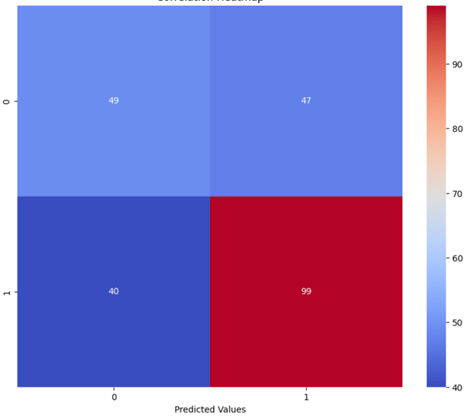
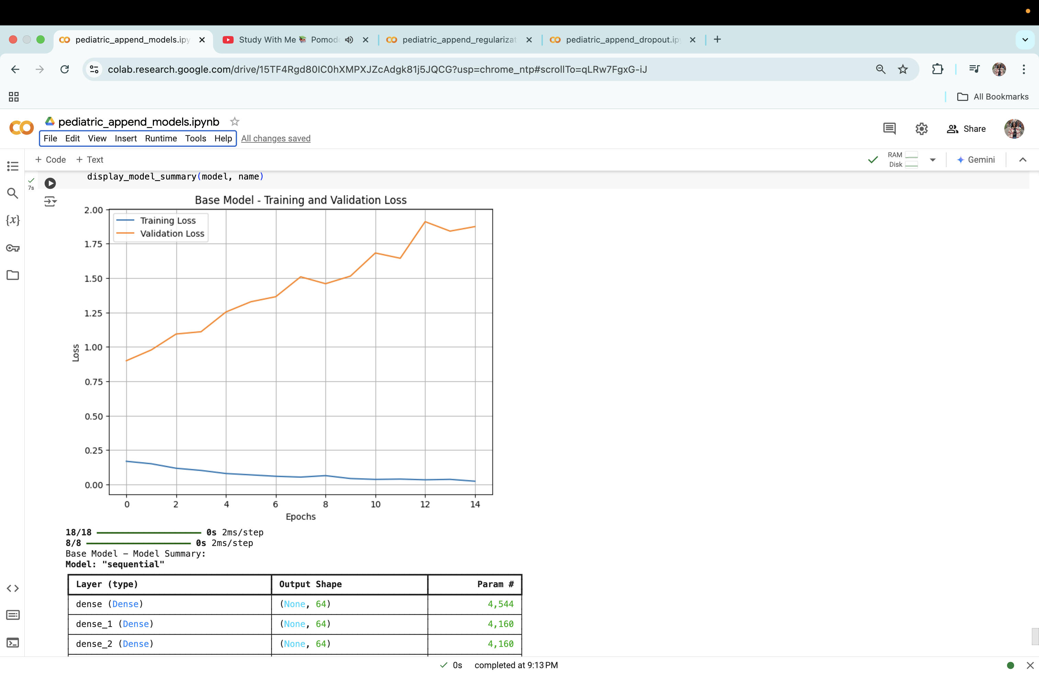
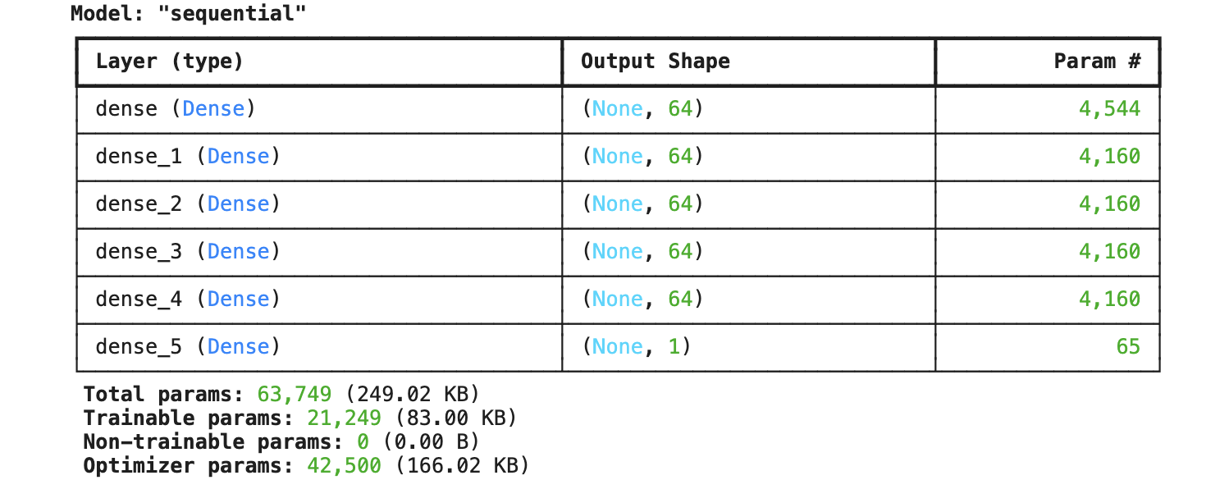
DNN –Base Model

Slide 14
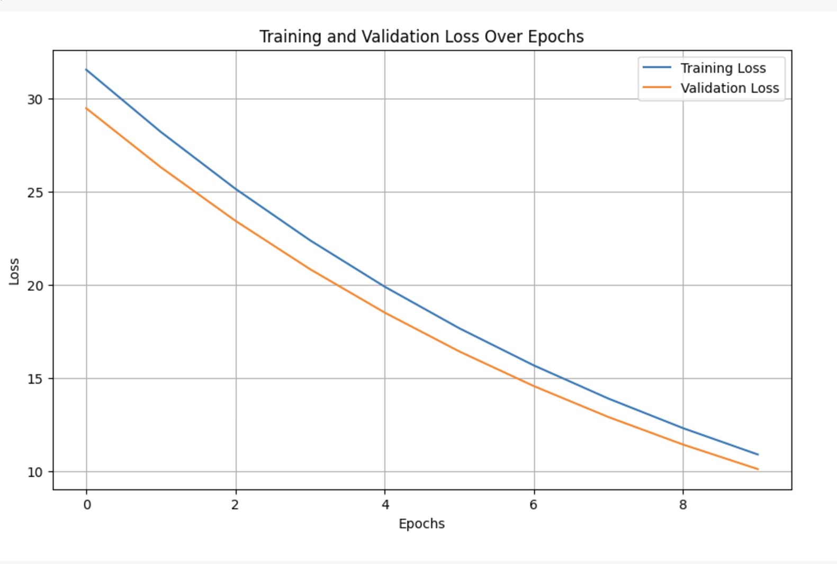
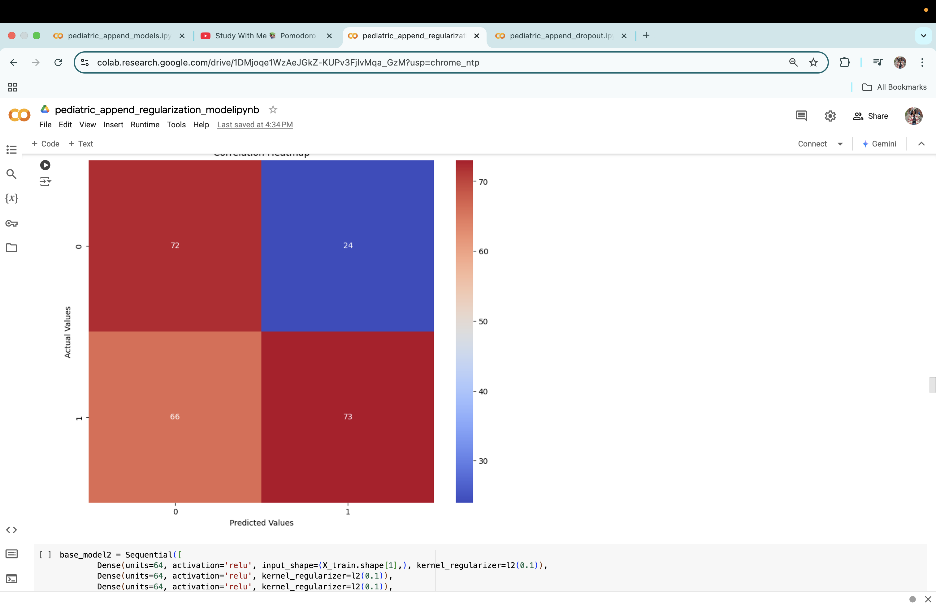
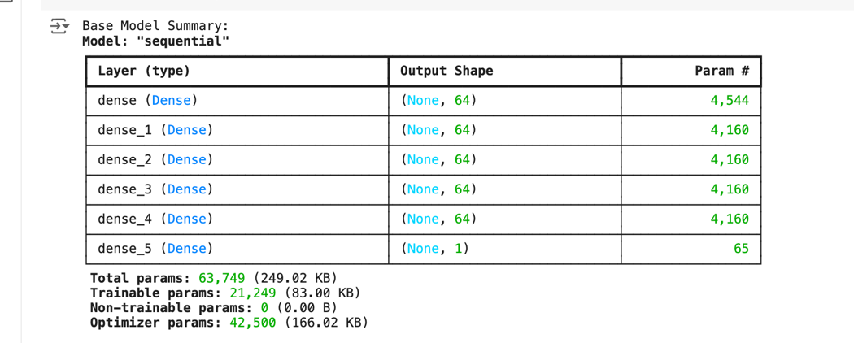
DNN- Tuned Model 1

Slide 15
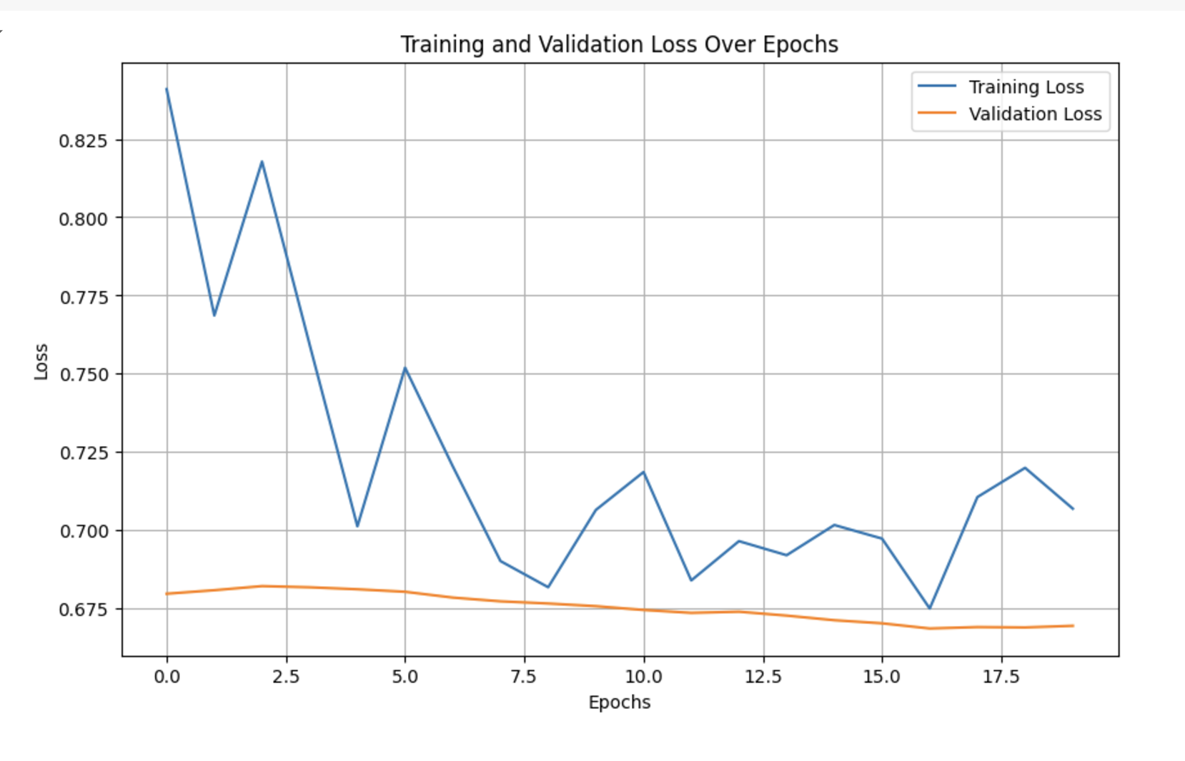
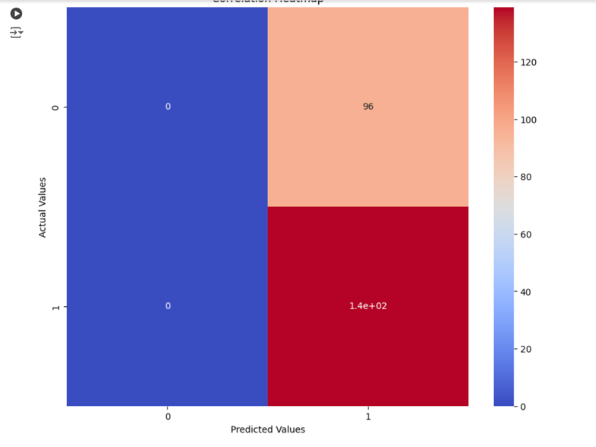
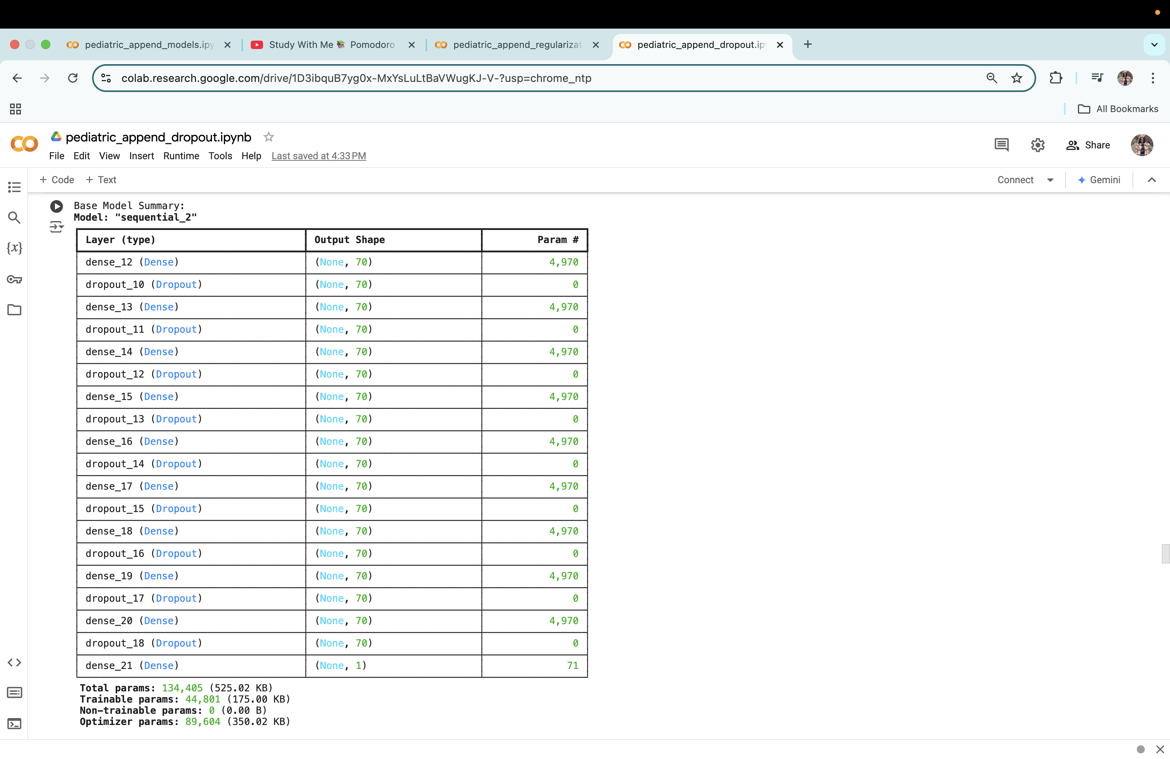
DNN- Tuned Model 2

Slide 16
What did you learn about this project :
Working with structured data, handling imbalanced datasets, and developing interpretable models.
This project could be a stepping stone toward more advanced healthcare applications or machine learning for impactful societal problems
What did you learn about this course ?
Understand the real-world challenges of applying machine learning in high-stakes fields like medicine.

Slide 17
Questions ?

Slide 18


Slide 19
 | Logistics | Decision Tree | Random Forest | SVM | ADA Boost | Gradient Boost | XGBoost | Light GBM | CatBoost
Accuracy | 0.68 | 0.62 | 0.73 | 0.70 | 0.71 | 0.71 | .065 | .70 | 0.67
F1 Score | 0: 0.62 1: 0.71 | 0: 0.56 1: 0.67 | 0: 0.62 1:0.79 | 0: 0.63 1: 0.75 | 0: 0.61 1: 0.76 | 0: 0.59 1: 0.78 | 0: 1.00 1: 1.00 | 0: 0.62 1: 0.75 | 0: 0.59 1: 0.73
Sensitivity (Recall) | 0: 0.52 1: 0.79 | 0: 0.61 1: 0.63 | .81 | 0: 0.62 1: 0.75 | 0: 0.56 1: 0.81 | 0: 0.51 1: 0.85 | 0: 1.00 1: 1.00 | 0: 0.60 1: 0.77 | 0: 0.58 1: 0.74
Specificity | 0.5 | 0.61 | 0.85 | 0.75 | 0.54 | 0.48 | 0.58 | 0.59 | 0.58

